Slide 1
Essential Singularities and the Great Picard Theorem
Maninder Dhanauta
April 6, 2023
University of Toronto Scarborough
MATD34 Complex Variables II
Notes:
ID=d924773e-9a16-4d6d-9803-8cb819e99682 Recipe=text_billboard Type=TextOnly Variant=0 FamilyID=AccentBoxWalbaum_Zero

Slide 2
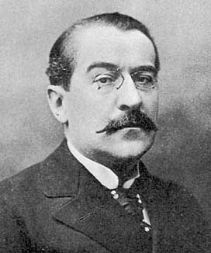
Agenda
Recap the classification Isolated Singularities (C34)
Linear Fractional Transformations (Mobius)
Weierstrass-Casorati Theorem
The Proof
Properties of Harmonic Functions
Integral formulas for Harmonic functions
Harnack-Type Results
Émile Picard (1856-1941)

Slide 3


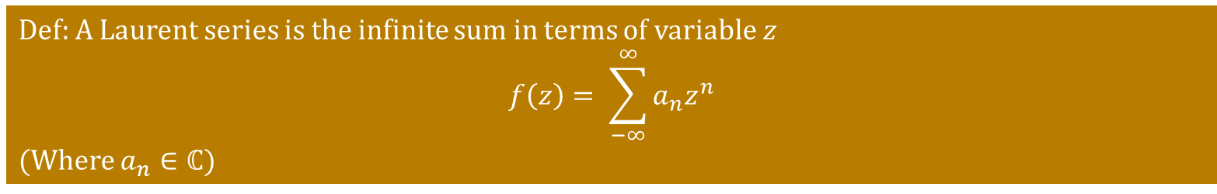
Recap: Laurent Series
Def: A Laurent series is the infinite sum in terms of variable $z$
$$f\left(z\right)= \sum_{−∞}^{∞}{a_{n}z^{n}}$$
(Where $a_{n}∈ℂ)$
It is possible that the sum f(z) doesn’t converge for any $z∈ℂ$
Let $S=\left\{z∈ℂ \right| f\left(z\right) converges\}≠Ø$. This subset of $ℂ$ looks like one of the following 4 possibilities:
Single Point Open Disk Punctured Disk Annulus
Notes:
Isolated zeros of non-constant holomophic functions
Valency and related questions
Implicit function theorem

Slide 4

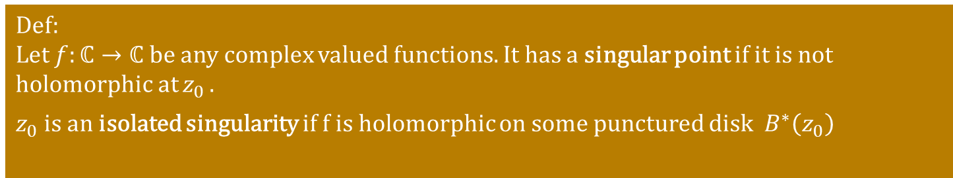
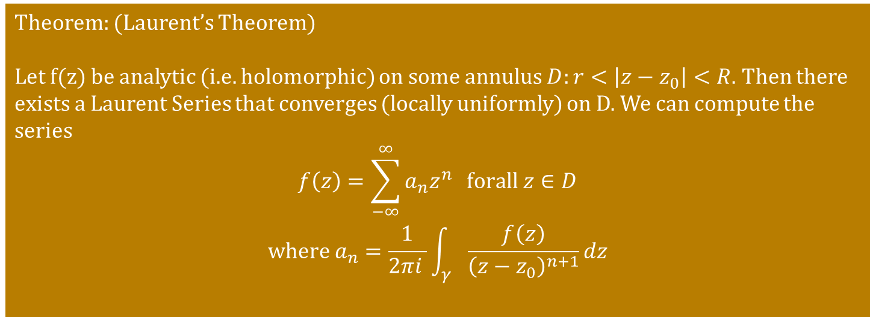
Recap: Isolated Singularities
Def:
Let $f:ℂ→ℂ$ be any complex valued functions. It has a singular point if it is not holomorphic at $z_{0 }$.
$z_{0}$ is an isolated singularity if f is holomorphic on some punctured disk $B^{∗}\left(z_{0}\right)$
The following theorem lets us classify isolated singularities using Laurent series
Theorem: (Laurent’s Theorem)
Let f(z) be analytic (i.e. holomorphic) on some annulus $D:r<\left|z−z_{0}\right|<R$. Then there exists a Laurent Series that converges (locally uniformly) on D. We can compute the series
$$f\left(z\right)=\sum_{−∞}^{∞}{a_{n}z^{n}} forall z∈D$$
$$where a_{n}=\frac{1}{2πi }\int_{γ}{\frac{f\left(z\right)}{{\left(z−z_{0}\right)}^{n+1}}dz}$$
Punctured disk is an annulus, thus has a Laurent series that converges to f(z)
Notes:
Isolated zeros of non-constant holomophic functions
Valency and related questions
Implicit function theorem

Slide 5
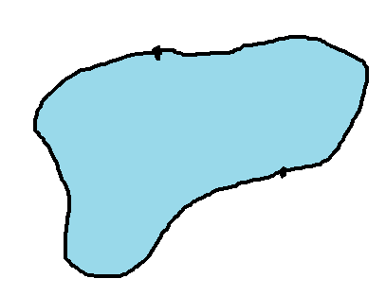
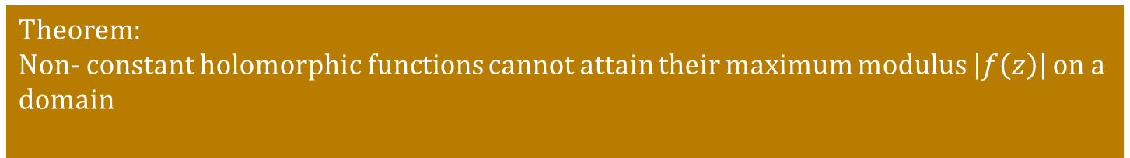
Recap: Maximum Modulus principle
Theorem:
Non- constant holomorphic functions cannot attain their maximum modulus $\left|f\left(z\right)\right|$ on a domain
The max can only be attained on the boundary
Notes:
Isolated zeros of non-constant holomophic functions
Valency and related questions
Implicit function theorem

Slide 6
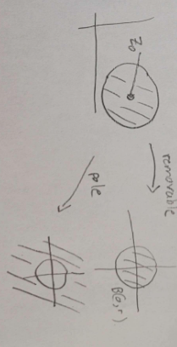
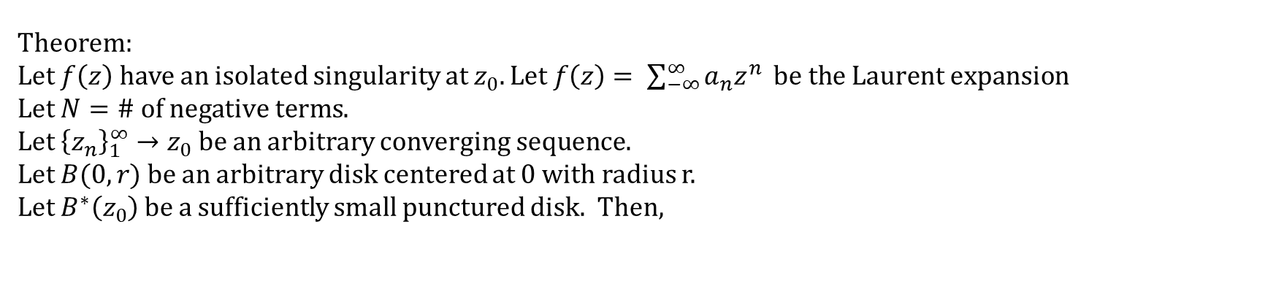
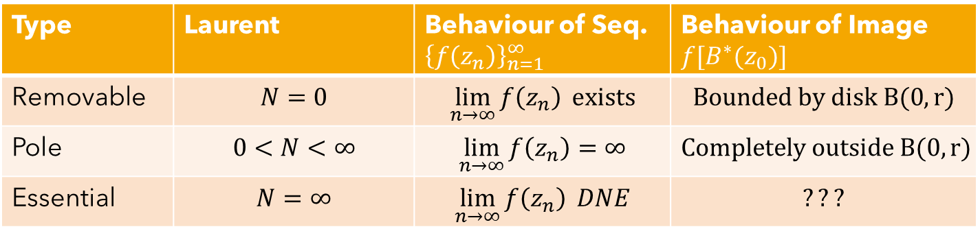
Recap: Classifying isolated singularities
Theorem:
Let $f\left(z\right)$ have an isolated singularity at $z_{0}. Let f\left(z\right)= \sum_{−∞}^{∞}{a_{n}z^{n}} be the Laurent expansion$
Let $N=\# of negative terms$.
Let ${\left\{z_{n}\right\}}_{1}^{∞}→z_{0}$ be an arbitrary converging sequence.
Let $B(0,r)$ be an arbitrary disk centered at 0 with radius r.
Let $B^{∗}\left(z_{0}\right)$ be a sufficiently small punctured disk. Then,
Type | Laurent | Behaviour of Seq. ${\left\{f\left(z_{n}\right)\right\}}_{n=1 }^{∞}$ | Behaviour of Image $f[B^{∗}(z_{0})]$
Removable | $$N=0$$ | $$\lim_{n→∞}{f\left(z_{n}\right)} exists$$ | $$Bounded by disk B(0,r)$$
Pole | $$0<N<∞$$ | $$\lim_{n→∞}{f\left(z_{n}\right)}=∞$$ | $$Completely outside B(0,r)$$
Essential | $$N=∞$$ | $$\lim_{n→∞}{f\left(z_{n}\right)} DNE$$ | $$???$$
Can the limit for essential singularity oscillate between two concentric circles (like sin(x) in $ℝ$) ? No because it becomes bounded

Slide 7
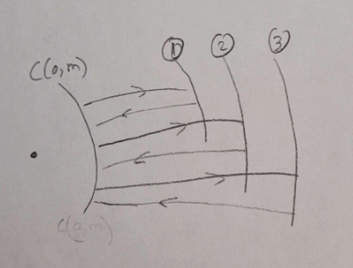
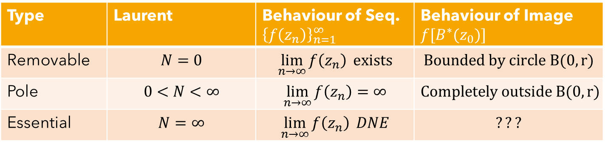
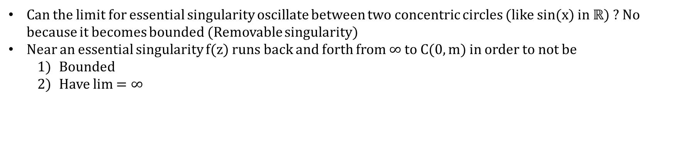
Recap: Classifying isolated singularities
Type | Laurent | Behaviour of Seq. ${\left\{f\left(z_{n}\right)\right\}}_{n=1 }^{∞}$ | Behaviour of Image $f[B^{∗}(z_{0})]$
Removable | $$N=0$$ | $$\lim_{n→∞}{f\left(z_{n}\right)} exists$$ | $$Bounded by circle B(0,r)$$
Pole | $$0<N<∞$$ | $$\lim_{n→∞}{f\left(z_{n}\right)}=∞$$ | $$Completely outside B(0,r)$$
Essential | $$N=∞$$ | $$\lim_{n→∞}{f\left(z_{n}\right)} DNE$$ | $$???$$
Can the limit for essential singularity oscillate between two concentric circles (like sin(x) in $ℝ$) ? No because it becomes bounded (Removable singularity)
Near an essential singularity f(z) runs back and forth from $∞ to C(0,m)$ in order to not be
Bounded
Have lim $=∞$
Notes:
Isolated zeros of non-constant holomophic functions
Valency and related questions
Implicit function theorem

Slide 8
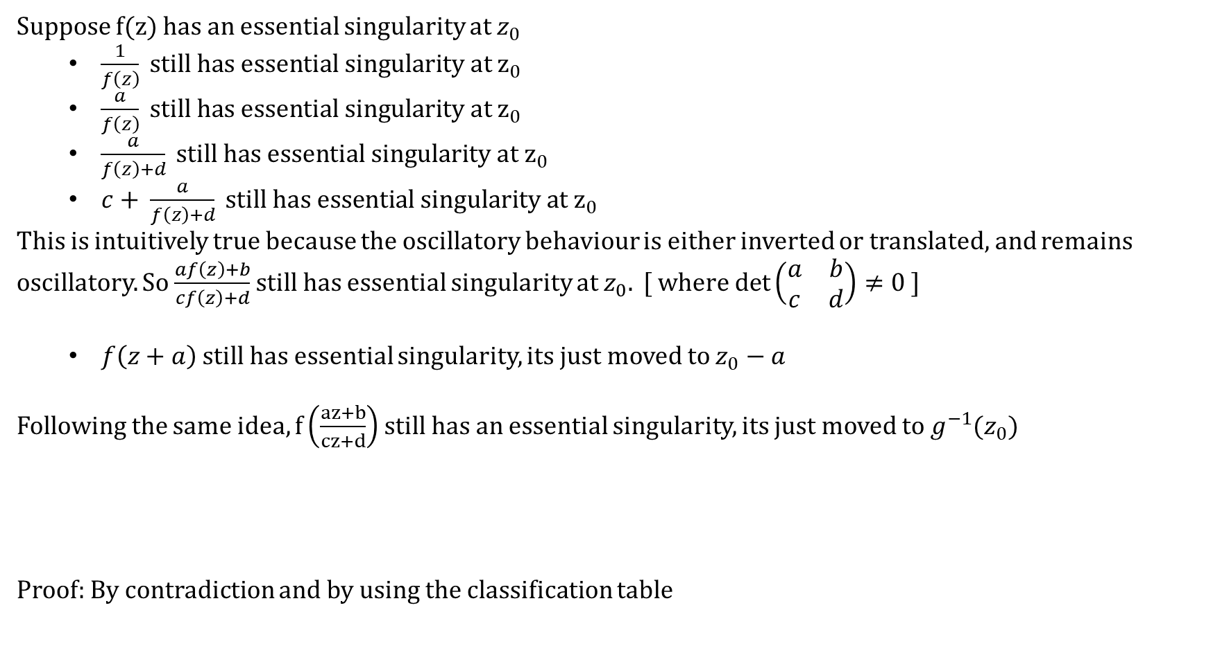
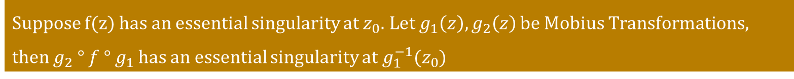
Mobius Transformations (LFT) and Essential Singularities
Suppose f(z) has an essential singularity at $z_{0}$
$\frac{1}{f\left(z\right)} still has essential singularity at z_{0}$
$\frac{a}{f\left(z\right)} still has essential singularity at z_{0}$
$\frac{a}{f\left(z\right)+d} still has essential singularity at z_{0}$
$c+ \frac{a}{f\left(z\right)+d} still has essential singularity at z_{0}$
This is intuitively true because the oscillatory behaviour is either inverted or translated, and remains oscillatory. So $\frac{af\left(z\right)+b}{cf\left(z\right)+d}$ still has essential singularity at $z_{0}. [ where det\left(\begin{matrix}a & b \\ c & d\end{matrix}\right)≠0 ]$
$f\left(z+a\right)$ still has essential singularity, its just moved to $z_{0}−a$
Following the same idea, $f\left(\frac{az+b}{cz+d}\right)$still has an essential singularity, its just moved to $g^{−1}(z_{0})$
Proof: By contradiction and by using the classification table
Suppose f(z) has an essential singularity at $z_{0}.$ Let $g_{1}\left(z\right), g_{2}\left(z\right)$ be Mobius Transformations, then $g_{2} ° f ° g_{1}$ has an essential singularity at $g_{1}^{−1}(z_{0})$
Notes:
Isolated zeros of non-constant holomophic functions
Valency and related questions
Implicit function theorem

Slide 9
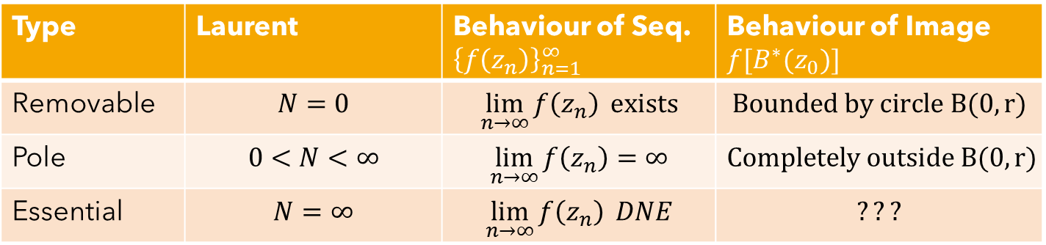
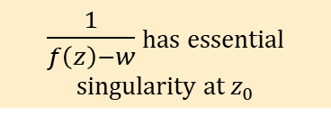
We can extend our table
Type | Laurent | Behaviour of Seq. ${\left\{f\left(z_{n}\right)\right\}}_{n=1 }^{∞}$ | Behaviour of Image $f[B^{∗}(z_{0})]$
Removable | $$N=0$$ | $$\lim_{n→∞}{f\left(z_{n}\right)} exists$$ | $$Bounded by circle B(0,r)$$
Pole | $$0<N<∞$$ | $$\lim_{n→∞}{f\left(z_{n}\right)}=∞$$ | $$Completely outside B(0,r)$$
Essential | $$N=∞$$ | $$\lim_{n→∞}{f\left(z_{n}\right)} DNE$$ | $$???$$
$\frac{1}{f\left(z\right)−w}$ has essential singularity at $z_{0}$
Notes:
Isolated zeros of non-constant holomophic functions
Valency and related questions
Implicit function theorem

Slide 10
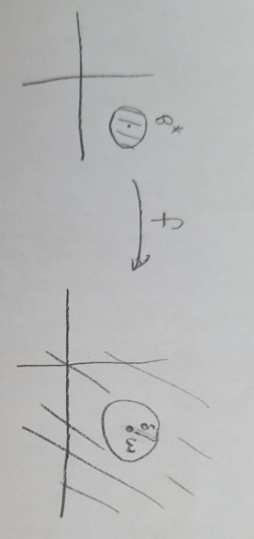
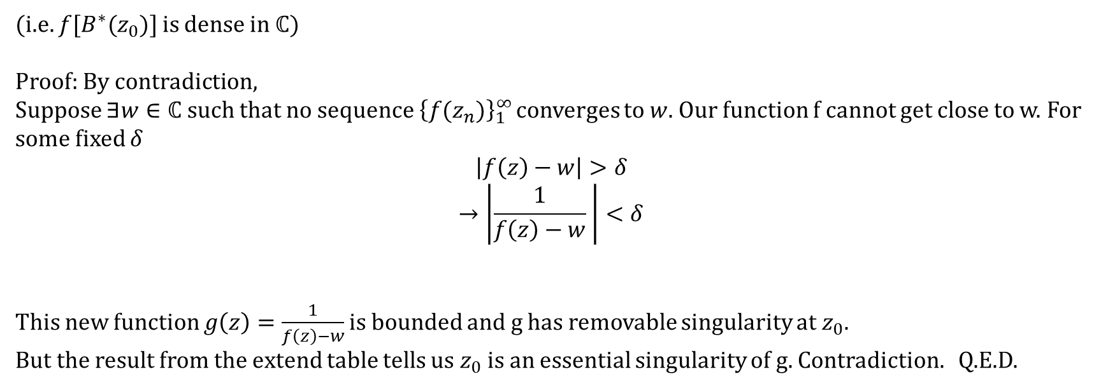
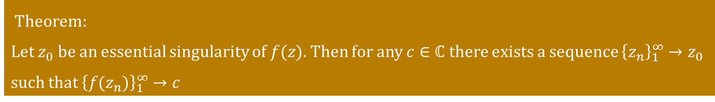
Weierstrauss-Casorati (Sokhotski’s) Theorem
Theorem:
Let $z_{0}$ be an essential singularity of $f(z)$. Then for any $c∈ℂ$ there exists a sequence ${\left\{z_{n}\right\}}_{1}^{∞}→z_{0}$ such that ${\left\{f(z_{n})\right\}}_{1}^{∞}→c$
(i.e. $f[B^{∗}(z_{0})]$ is dense in $ℂ$)
Proof: By contradiction,
Suppose $∃w∈ℂ$ such that no sequence ${\left\{f(z_{n})\right\}}_{1}^{∞}$ converges to $w$. Our function f cannot get close to w. For some fixed $δ$
$$\left|f\left(z\right)−w\right|>δ$$
$$→\left|\frac{1}{f\left(z\right)−w} \right|<δ$$
This new function $g\left(z\right)=\frac{1}{f\left(z\right)−w}$ is bounded and g has removable singularity at $z_{0}$.
But the result from the extend table tells us $z_{0}$ is an essential singularity of g. Contradiction. Q.E.D.

Slide 11
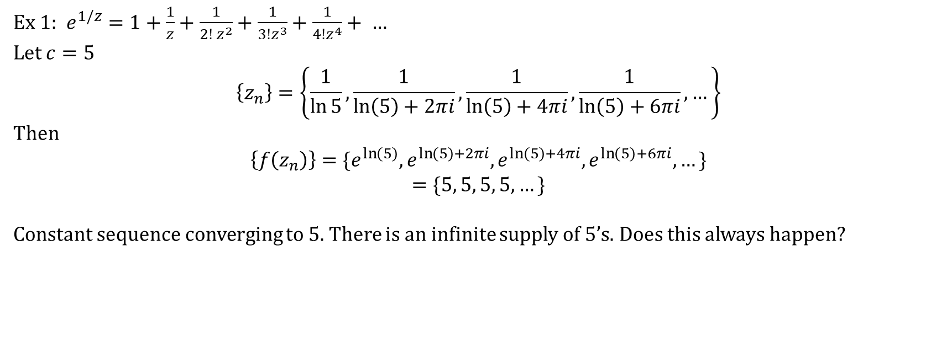
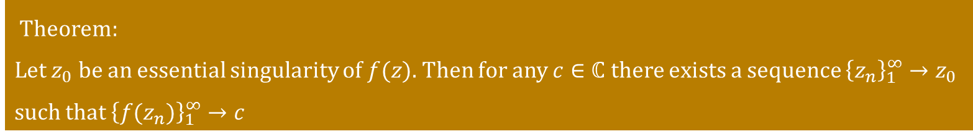
Theorem:
Let $z_{0}$ be an essential singularity of $f(z)$. Then for any $c∈ℂ$ there exists a sequence ${\left\{z_{n}\right\}}_{1}^{∞}→z_{0}$ such that ${\left\{f(z_{n})\right\}}_{1}^{∞}→c$
Ex 1: $e^{1/z}=1+\frac{1}{z}+\frac{1}{2! z^{2}}+\frac{1}{3!z^{3}}+\frac{1}{4!z^{4}}+ …$
Let $c=5$
$$\left\{z_{n}\right\}=\left\{\frac{1}{\ln{5}}, \frac{1}{\ln\left(5\right)+2πi}, \frac{1}{\ln\left(5\right)+4πi},\frac{1}{\ln\left(5\right)+6πi}, …\right\}$$
Then
$$\left\{f\left(z_{n}\right)\right\}=\{e^{\ln\left(5\right)},e^{\ln\left(5\right)+2πi},e^{\ln\left(5\right)+4πi},e^{\ln\left(5\right)+6πi},…\}$$
$$=\{5, 5, 5, 5,…\}$$
Constant sequence converging to 5. There is an infinite supply of 5’s. Does this always happen?

Slide 12
Entire Injective functions
Ex 2:

Slide 13
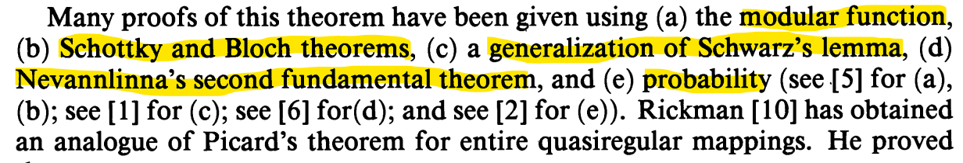
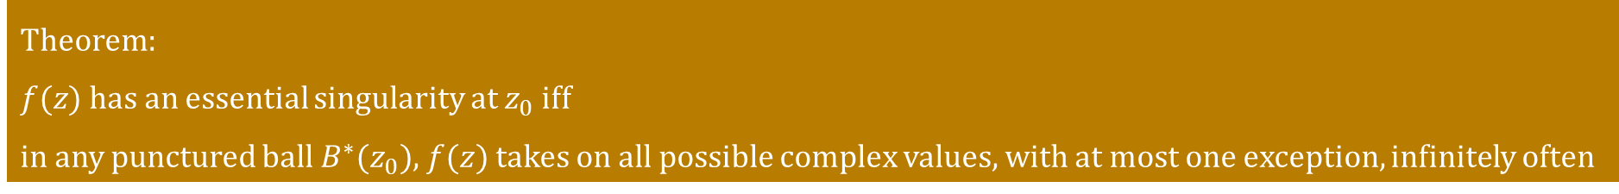
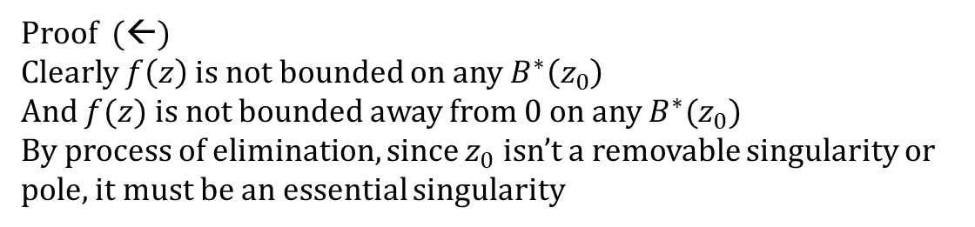
The Great Picard Theorem
Theorem:
$f(z)$ has an essential singularity at $z_{0}$ iff
in any punctured ball $B^{∗}(z_{0})$, $f(z)$ takes on all possible complex values, with at most one exception, infinitely often
Proof (←)
Clearly $f\left(z\right)$ is not bounded on any $B^{∗}\left(z_{0}\right)$
And $f(z)$ is not bounded away from 0 on any $B^{∗}(z_{0})$
By process of elimination, since $z_{0}$ isn’t a removable singularity or pole, it must be an essential singularity

Slide 14
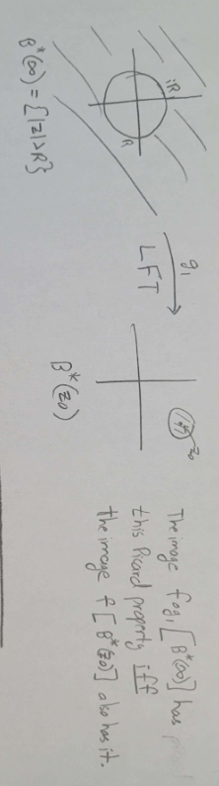
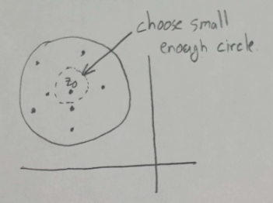
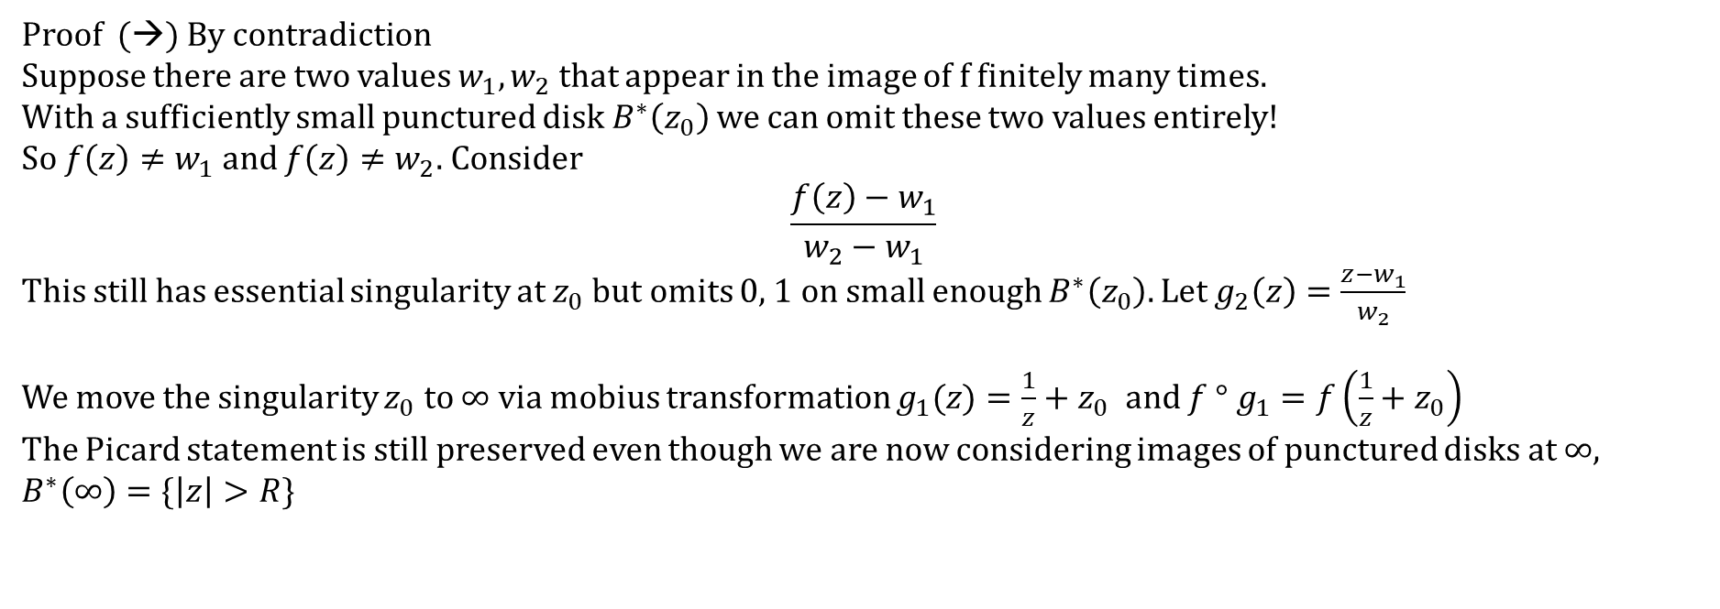
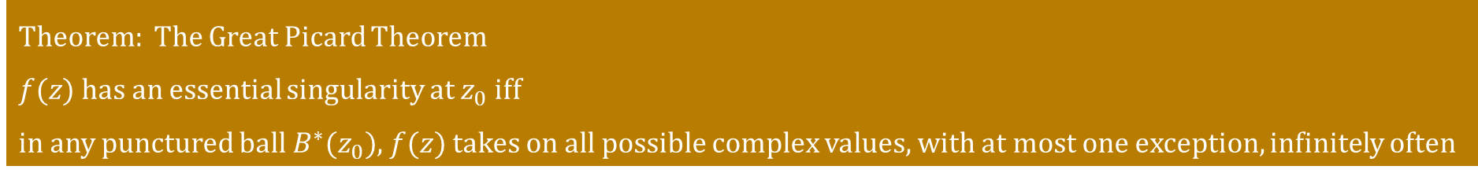
Theorem: The Great Picard Theorem
$f(z)$ has an essential singularity at $z_{0}$ iff
in any punctured ball $B^{∗}(z_{0})$, $f(z)$ takes on all possible complex values, with at most one exception, infinitely often
Proof (→) By contradiction
Suppose there are two values $w_{1},w_{2}$ that appear in the image of f finitely many times.
With a sufficiently small punctured disk $B^{∗}\left(z_{0}\right)$ we can omit these two values entirely!
So $f\left(z\right)≠w_{1} and f\left(z\right)≠w_{2}$. Consider
$$\frac{f\left(z\right)−w_{1}}{w_{2}−w_{1}}$$
This still has essential singularity at $z_{0}$ but omits 0, 1 on small enough $B^{∗}\left(z_{0}\right).$ Let $g_{2}\left(z\right)=\frac{z−w_{1}}{w_{2}}$
We move the singularity $z_{0}$ to $∞$ via mobius transformation $g_{1}(z)=\frac{1}{z}+z_{0}$ and $f ° g_{1}=f\left(\frac{1}{z}+z_{0}\right)$
The Picard statement is still preserved even though we are now considering images of punctured disks at $∞, B^{∗}\left(∞\right)=\{\left|z\right|>R\}$

Slide 15
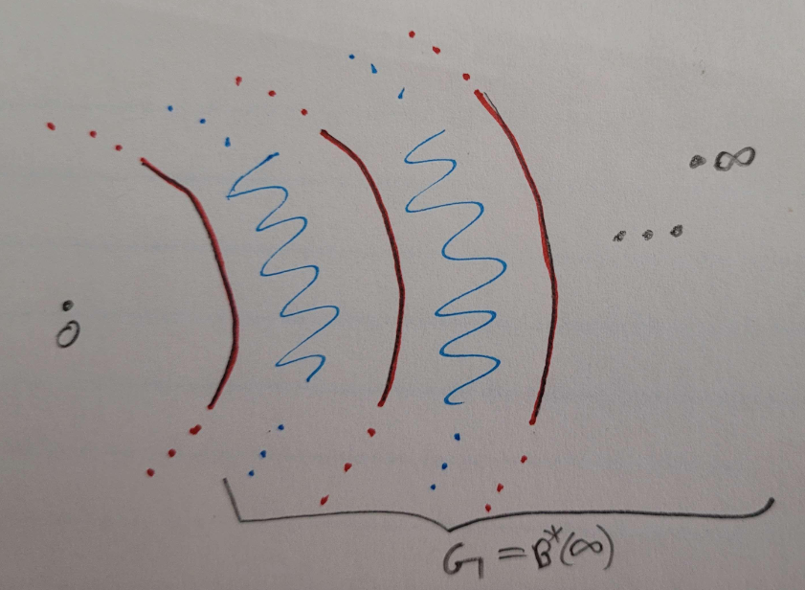
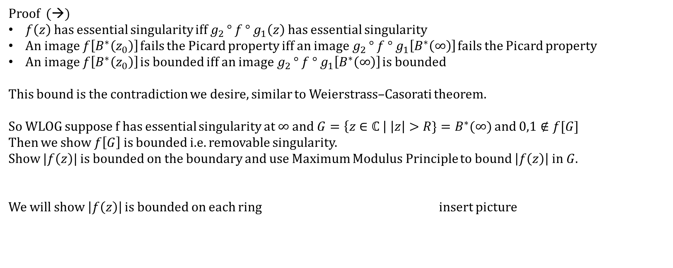
Theorem: The Great Picard Theorem
$f(z)$ has an essential singularity at $z_{0}$ iff
in any punctured ball $B^{∗}(z_{0})$, $f(z)$ takes on all possible complex values, with at most one exception, infinitely often
Proof (→)
$f\left(z\right)$has essential singularity iff $g_{2 }° f ° g_{1}\left(z\right)$ has essential singularity
An image $f\left[B^{∗}\left(z_{0}\right)\right]$ fails the Picard property iff an image$g_{2 }° f ° g_{1}\left[B^{∗}\left(∞\right)\right]$ fails the Picard property
An image $f\left[B^{∗}\left(z_{0}\right)\right]$ is bounded iff an image$g_{2 }° f ° g_{1}\left[B^{∗}\left(∞\right)\right]$ is bounded
This bound is the contradiction we desire, similar to Weierstrass–Casorati theorem.
So WLOG suppose f has essential singularity at $∞$ and $G=\left\{z∈ℂ \right| \left|z\right|>R\}=B^{∗}(∞)$ and $0,1∉f[G]$
Then we show $f\left[G\right]$ is bounded i.e. removable singularity.
Show $|f\left(z\right)|$ is bounded on the boundary and use Maximum Modulus Principle to bound $\left|f\left(z\right)\right| in G$.
We will show $\left|f\left(z\right)\right|$ is bounded on each ring insert picture

Slide 16
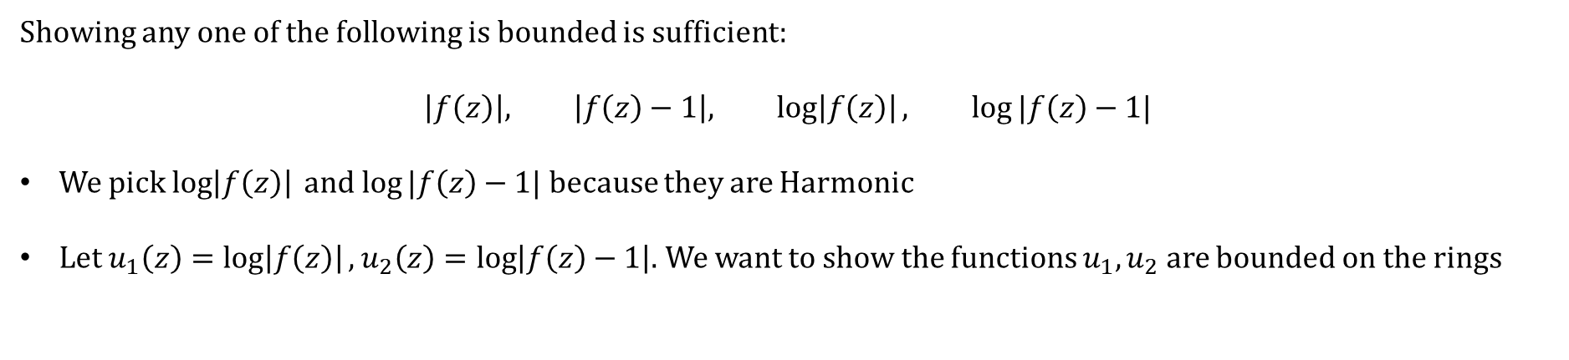
Showing any one of the following is bounded is sufficient:
$$\left|f\left(z\right)\right|, \left|f\left(z\right)−1\right|, \log\left|f\left(z\right)\right|, log⁡|f\left(z\right)−1|$$
We pick $\log\left|f\left(z\right)\right| and log⁡|f\left(z\right)−1|$ because they are Harmonic
Let $u_{1}\left(z\right)=\log\left|f\left(z\right)\right|, u_{2}\left(z\right)=\log\left|f\left(z\right)−1\right|$. We want to show the functions $u_{1},u_{2}$ are bounded on the rings

Slide 17
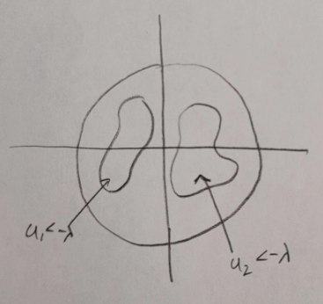
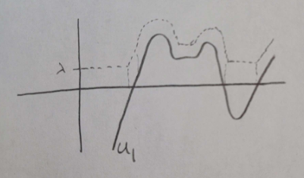
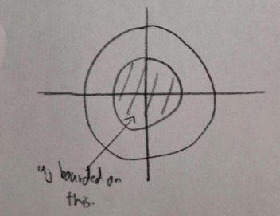

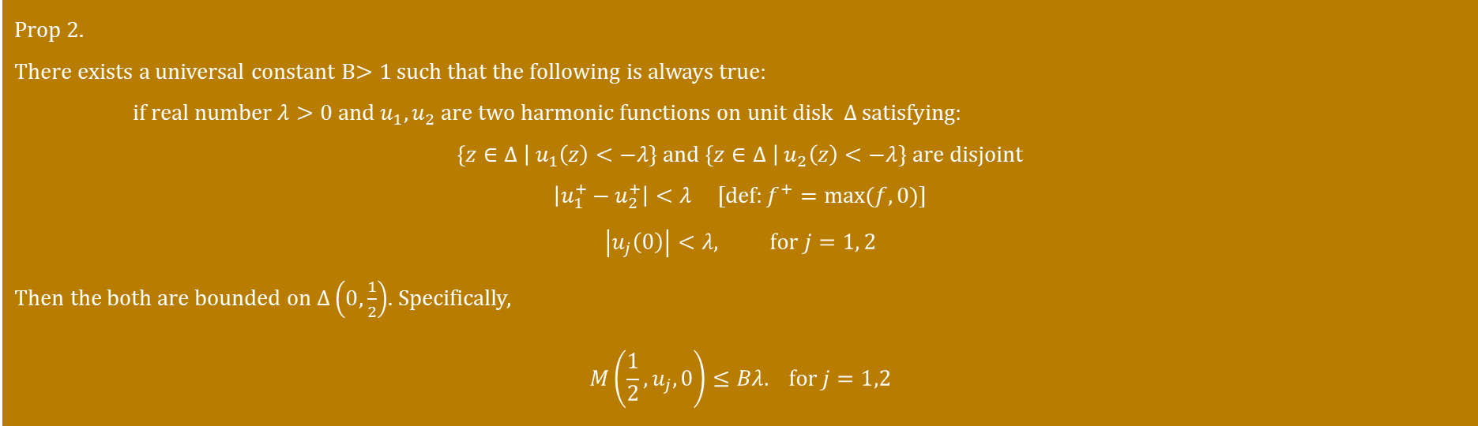
We pick $\log\left|f\left(z\right)\right| and log⁡|f\left(z\right)−1|$ because they are Harmonic
Prop 2.
There exists a universal constant B$>1$ such that the following is always true:
if real number $λ>0$ and $u_{1},u_{2}$ are two harmonic functions on unit disk $Δ$ satisfying:
$$\left\{z∈Δ \right| u_{1}\left(z\right)<−λ\} and \left\{z∈Δ \right| u_{2}\left(z\right)<−λ\} are disjoint$$
$$\left|u_{1}^{+}−u_{2}^{+}\right|<λ [def:f^{+}=max⁡(f,0)]$$
$$\left|u_{j}\left(0\right)\right|<λ, for j=1, 2$$
Then the both are bounded on $Δ\left(0,\frac{1}{2}\right)$. Specifically,
$$M\left(\frac{1}{2},u_{j},0\right)≤Bλ. for j=1,2$$
Then →
“Sufficiently negative values share the disk but live on disjoint regions”
“$u_{2}$ must fall below the dotted curve”
Rest of the proof on chalkboard
Notes:
Mistake here in the second diagram, there are dotted lines below the graph and above the x-axis

Slide 18
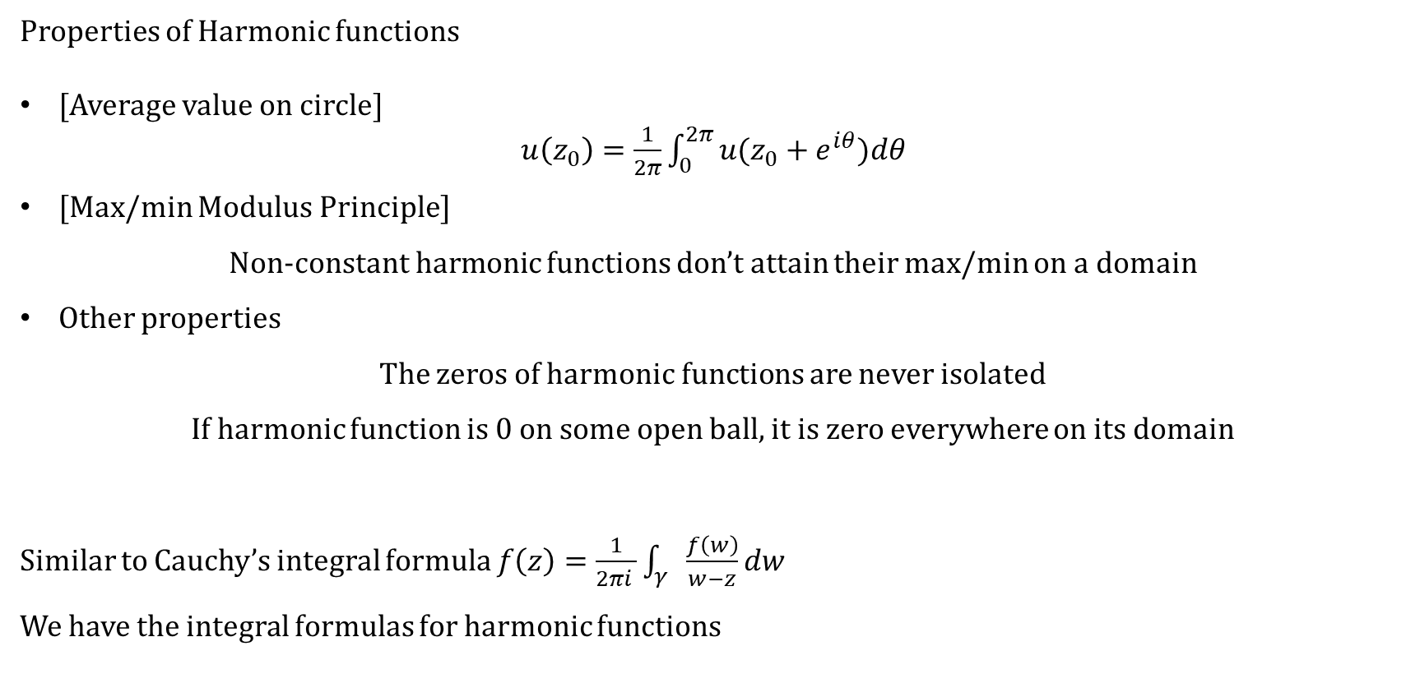
Harmonic functions
Properties of Harmonic functions
[Average value on circle]
$u\left(z_{0}\right)=\frac{1}{2π}\int_{0}^{2π}{u(z_{0}+e^{iθ})dθ}$
[Max/min Modulus Principle]
Non-constant harmonic functions don’t attain their max/min on a domain
Other properties
The zeros of harmonic functions are never isolated
If harmonic function is 0 on some open ball, it is zero everywhere on its domain
Similar to Cauchy’s integral formula $f\left(z\right)=\frac{1}{2πi }\int_{γ}{\frac{f\left(w\right)}{w−z}dw}$
We have the integral formulas for harmonic functions
Notes:
Now we can say period of f is same as point in the lattice

Slide 19
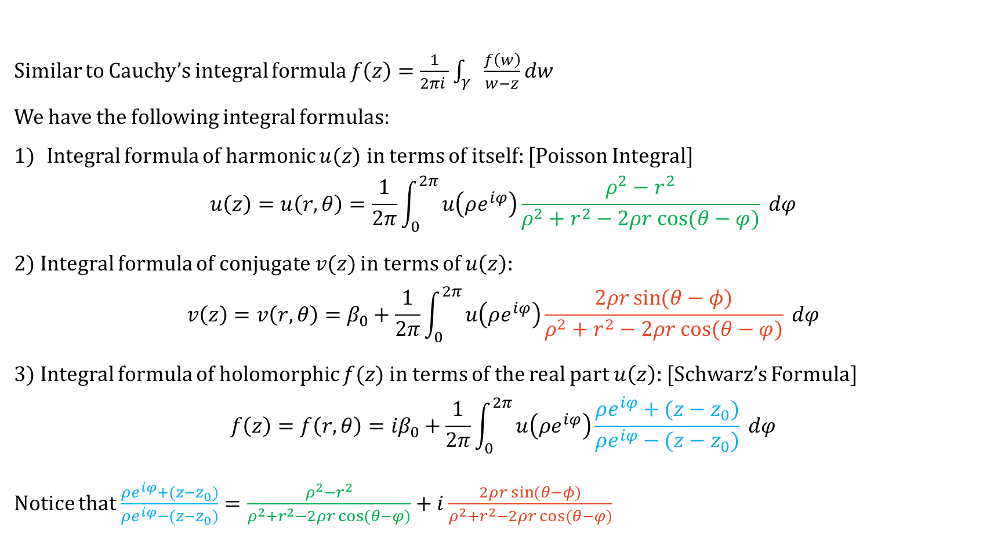
Harmonic functions
Similar to Cauchy’s integral formula $f\left(z\right)=\frac{1}{2πi }\int_{γ}{\frac{f\left(w\right)}{w−z}dw}$
We have the following integral formulas:
Integral formula of harmonic $u(z)$ in terms of itself: [Poisson Integral]
$$u\left(z\right)=u\left(r,θ\right)=\frac{1}{2π}\int_{0}^{2π}{u\left(ρe^{iφ}\right)\frac{ρ^{2}−r^{2}}{ρ^{2}+r^{2}−2ρr cos⁡(θ−φ)}} dφ$$
2) Integral formula of conjugate $v(z)$ in terms of $u\left(z\right):$
$$v\left(z\right)=v\left(r,θ\right)=β_{0}+\frac{1}{2π}\int_{0}^{2π}{u\left(ρe^{iφ}\right)\frac{2ρr\sin{(θ−φ)}}{ρ^{2}+r^{2}−2ρr cos⁡(θ−φ)}} dφ$$
3) Integral formula of holomorphic $f(z)$ in terms of the real part $u\left(z\right):$ [Schwarz’s Formula]
$$f\left(z\right)=f\left(r,θ\right)={iβ}_{0}+\frac{1}{2π}\int_{0}^{2π}{u\left(ρe^{iφ}\right)\frac{ρe^{iφ}+(z−z_{0})}{ρe^{iφ}−(z−z_{0})}} dφ$$
Notice that $\frac{ρe^{iφ}+(z−z_{0})}{ρe^{iφ}−(z−z_{0})}=\frac{ρ^{2}−r^{2}}{ρ^{2}+r^{2}−2ρr cos⁡(θ−φ)}+i\frac{2ρr\sin{(θ−φ)}}{ρ^{2}+r^{2}−2ρr cos⁡(θ−φ)}$
Notes:
Now we can say period of f is same as point in the lattice

Slide 20




Why is this proof called Harnack-Type inequality?
Harnack’s Inequality
Let u be a positive harmonic function in the disk $Δ(w,R)$, then
$$\frac{1}{3}u\left(w\right)≤u\left(z\right)≤3u\left(w\right), ∀z∈\overline{Δ\left(w,\frac{R}{2}\right)}$$
The function must be fairly close to the value at the center h(w)
Why?
$$\frac{1}{3}<\frac{ρ^{2}−r^{2}}{ρ^{2}+r^{2}−2ρr cos⁡(θ−φ)}<3$$
Apply Average value and integral formulas to get:
$$\frac{1}{3}u\left(w\right)≤u\left(z\right)≤3u\left(w\right)$$
$$\frac{1}{3}\frac{1}{2π}\int_{0}^{2π}{u\left(ρe^{iφ}\right)} dφ$$
$$<\frac{1}{2π}\int_{0}^{2π}{u\left(ρe^{iφ}\right)\frac{ρ^{2}−r^{2}}{ρ^{2}+r^{2}−2ρr cos⁡(θ−φ)}} dφ<$$
$$3\frac{1}{2π}\int_{0}^{2π}{u\left(ρe^{iφ}\right)} dφ$$
Notes:
Now we can say period of f is same as point in the lattice

Slide 21
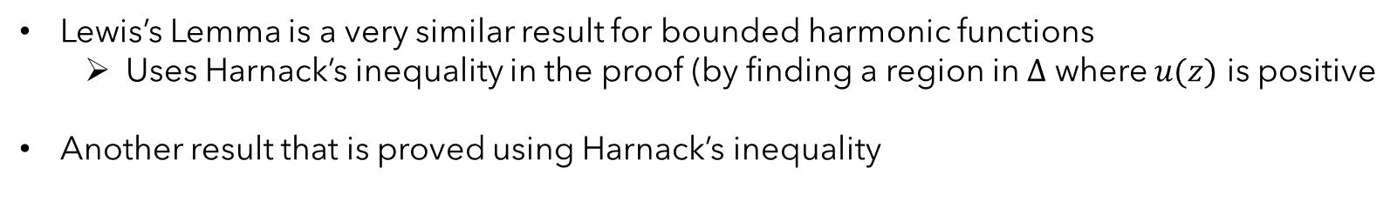
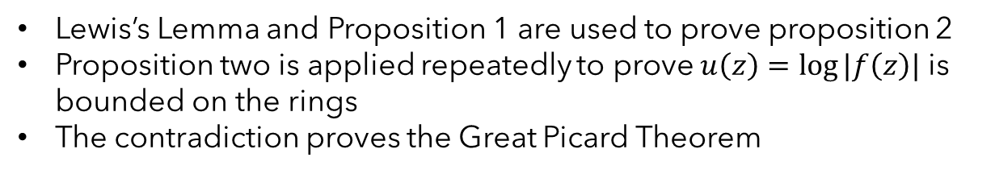
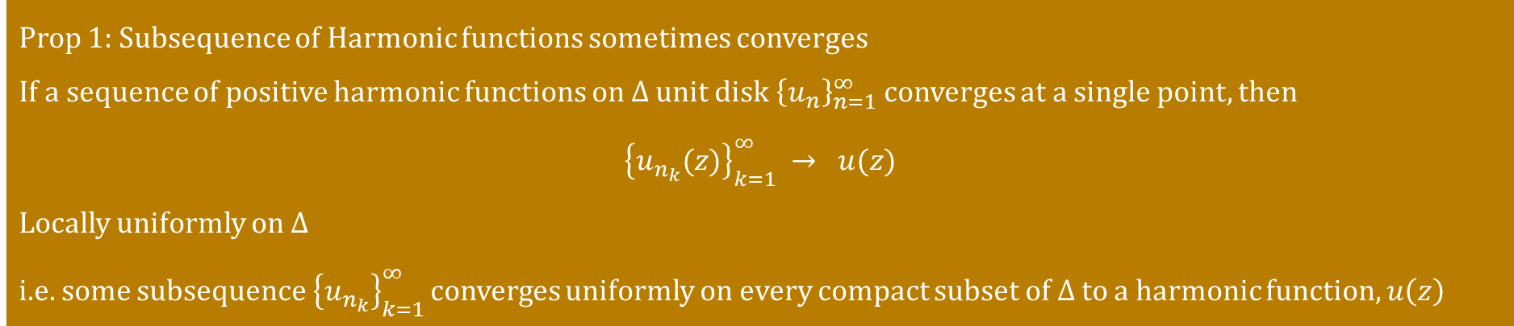
Why is this proof called Harnack-Type inequality?
Lewis’s Lemma is a very similar result for bounded harmonic functions
Uses Harnack’s inequality in the proof (by finding a region in $Δ$ where $u(z)$ is positive
Another result that is proved using Harnack’s inequality
Prop 1: Subsequence of Harmonic functions sometimes converges
If a sequence of positive harmonic functions on $Δ$ unit disk ${\left\{u_{n}\right\}}_{n=1}^{∞}$ converges at a single point, then
$${\left\{u_{n_{k}}(z)\right\}}_{k=1 }^{∞}→ u(z)$$
Locally uniformly on $Δ$
i.e. some subsequence ${\left\{u_{n_{k}}\right\}}_{k=1 }^{∞}$converges uniformly on every compact subset of $Δ$ to a harmonic function, $u\left(z\right)$
Lewis’s Lemma and Proposition 1 are used to prove proposition 2
Proposition two is applied repeatedly to prove $u\left(z\right)=\log{|f\left(z\right)|}$ is bounded on the rings
The contradiction proves the Great Picard Theorem
Notes:
Now we can say period of f is same as point in the lattice

Slide 22
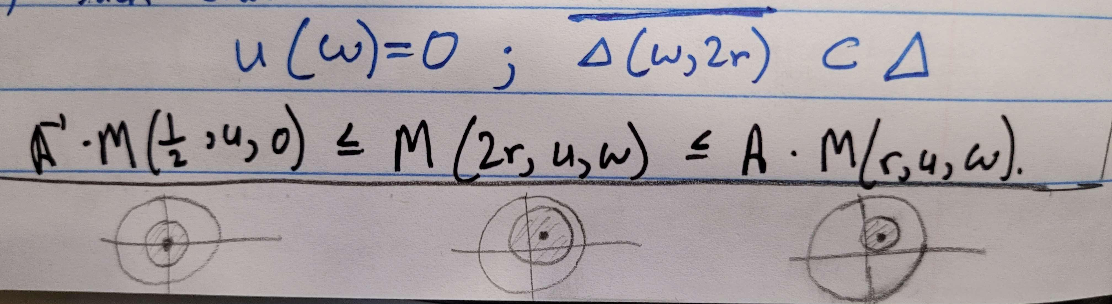
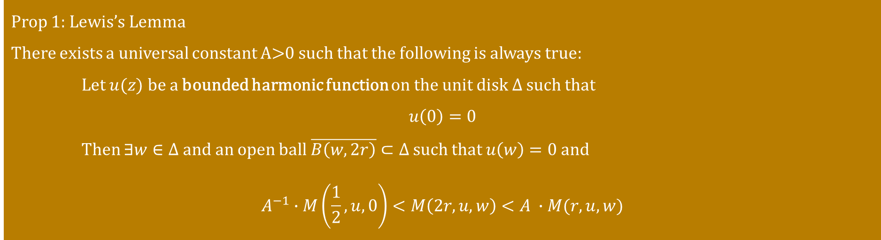
Prop 1: Lewis’s Lemma
There exists a universal constant A>0 such that the following is always true:
Let $u(z)$ be a bounded harmonic function on the unit disk $Δ$ such that
$$u\left(0\right)=0$$
Then $∃w∈Δ$ and an open ball $\overline{B\left(w,2r\right)}⊂Δ$ such that $u\left(w\right)=0$ and
$$A^{−1}∙M\left(\frac{1}{2},u,0\right)<M\left(2r,u,w\right)<A ∙M(r,u,w)$$
Notes:
Now we can say period of f is same as point in the lattice

Slide 23
References
Daniel Girela, A proof of the Great Picard Theorem, Bull. Belg. Math. Soc. 10(2003), 271-280
A.I. Markushevich, Theory of Functions of a Complex Variable Vol. 2, Prentice-Hall, Inc (1965)
J. L. Lewis, Picard’s Theorem and Rickman’s theorem by way of Harnack’s inequality, Proc. Amer. Math. Soc. 122 (1994), no. 1, 199-206;
E. Stien & R. Shakarchi, Complex Analysis, Princeton University Press (2003)
Course notes from MATC34 and MATD34
Notes:
Now we can say period of f is same as point in the lattice

Slide 24

Thank you for listening!
Notes:
Now we can say period of f is same as point in the lattice

